Slide 1
Timer Control
Ajax

Slide 2
Timer Control
The Timer control performs postbacks at defined intervals. If you use the Timer control with an UpdatePanel control, you can enable partial-page updates at a defined interval. You can also use the Timer control to post the whole page.

Slide 3
Timer Control
You use the Timer control when you want to do the following:
Periodically update the contents of one or more UpdatePanel controls without refreshing the whole Web page.
Run code on the server every time that a Timer control causes a postback.
Synchronously post the whole Web page to the Web server at defined intervals.

Slide 4
Timer Control
The Timer control is a server control that embeds a JavaScript component into the Web page. The JavaScript component initiates the postback from the browser when the interval that is defined in the Interval property has elapsed. You set the properties for the Timer control in code that runs on the server and those properties are passed to the JavaScript component.

Slide 5
Timer Control
An instance of the ScriptManager class must be included in the Web page when you use the Timer control.
When a postback was initiated by the Timer control, the Timer control raises the Tick event on the server. You can create an event handler for the Tick event to perform actions when the page is posted to the server.

Slide 6
Timer Control
Set the Interval property to specify how often postbacks will occur, and set the Enabled property to turn the Timer on or off. The Interval property is defined in milliseconds and has a default value of 60,000 milliseconds, or 60 seconds.

Slide 7
Timer Control
You can include more than one Timer control on a Web page if different UpdatePanel controls must be updated at different intervals. Alternatively, a single instance of the Timer control can be the trigger for more than one UpdatePanel control in a Web page.

Slide 8
Timer Control
When the Timer control is included inside an UpdatePanel control, the Timer control automatically works as a trigger for the UpdatePanel control. You can override this behavior by setting the ChildrenAsTriggers property of the UpdatePanel control to false.

Slide 9
Timer Control
For Timer controls inside an UpdatePanel control, the JavaScript timing component is re-created only when each postback finishes. Therefore, the timed interval does not start until the page returns from the postback. For instance, if the Interval property is set to 60,000 milliseconds (60 seconds) but the postback takes 3 seconds to complete, the next postback will occur 63 seconds after the previous postback.

Slide 10
Timer Control
When the Timer control is outside an UpdatePanel control, you must explicitly define the Timer control as a trigger for the UpdatePanel control to be updated. If the Timer controls is outside an UpdatePanel control, the JavaScript timing component continues to run as the postback is being processed.

Slide 11
Timer Control
You must set the Interval property to a value that enables one asynchronous postback to complete before the next postback is initiated. If a new postback is initiated while an earlier postback is being processed, the first postback is canceled.

Slide 12
To refresh an UpdatePanel control at a timed interval Example
Create a new page and switch to Design view.
If the page does not already contain a ScriptManager control, in the tab of the toolbox, double-click the ScriptManager control to add it to the page.
In the toolbox, double-click the UpdatePanel control to add it to the page.
Click inside the UpdatePanel control and then double-click the Timer control to add it to the UpdatePanel control.

Slide 13
To refresh an UpdatePanel control at a timed interval Example
If the page does not already contain a ScriptManager control, in the tab of the toolbox, double-click the ScriptManager control to add it to the page.
In the toolbox, double-click the UpdatePanel control to add it to the page.
Click inside the UpdatePanel control and then double-click the Timer control to add it to the UpdatePanel control.

Slide 14
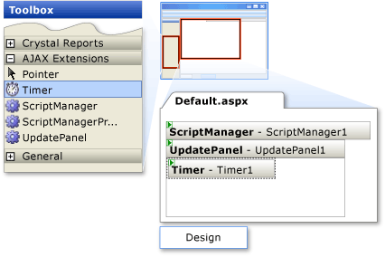
To refresh an UpdatePanel control at a timed interval Example

Slide 15
To refresh an UpdatePanel control at a timed interval Example
Set the Interval property of the Timer control to 10000.
Click inside the UpdatePanel control and then in the tab of the toolbox, double-click the Label control to add it to the UpdatePanel control.
Set the label's Text property to .
Click outside the UpdatePanel control and double-click the Label control to add a second label outside the UpdatePanel control.

Slide 16
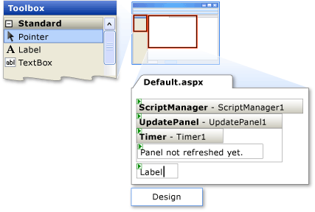
To refresh an UpdatePanel control at a timed interval Example

Slide 17
To refresh an UpdatePanel control at a timed interval Example
Double-click the Timer control to create a handler for the Tick event.
Add code that sets the Text property of the control to the current time.
Create a Page_Load handler and add code that sets the Text property of the control to the time that the page is created.

Slide 18
To refresh an UpdatePanel control at a timed interval Example
Partial Class _Default Inherits System.Web.UI.Page
Protected Sub Page_Load(ByVal sender As Object, ByVal e As System.EventArgs) Handles Me.Load
Label2.Text = "Page created at: " & _ DateTime.Now.ToLongTimeString()
End Sub
Protected Sub Timer1_Tick(ByVal sender As Object, ByVal e As System.EventArgs)
Label1.Text = "Panel refreshed at: " & _ DateTime.Now.ToLongTimeString()
End Sub
End Class

Slide 19
To refresh an UpdatePanel control at a timed interval Example
Save your changes and press CTRL+F5 to view the page in a browser.
Wait at least 10 seconds for panel to refresh.
The text inside the panel changes to display the last time that the panel's content was refreshed. However, the text outside the panel is not refreshed.

